Slide 1
Arduino Workshop #10
Hardware and Timer Interrupts

Slide 2
PowerPoint and Code
Github.com/EELabMan
Go To Repositories and find Arduino 10 Hardware and timer interrupts

Slide 3
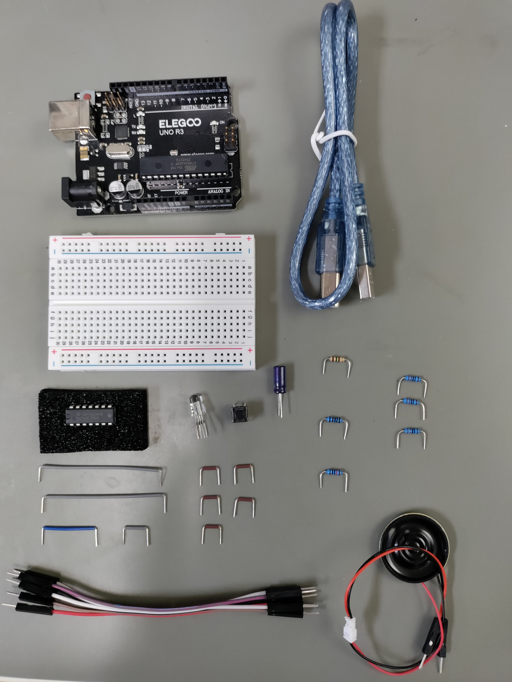
Parts
Arduino Uno
USB Cable
Breadboard
150Ω
3 – 220Ω
Button
1kΩ
74HC14
10uF
RGB LED
10kΩ
Breadboard Wires
2 – Grey 2.1”
1 – Blue 0.9”
1 – Grey 0.5”
5 – Brown 0.4”
Speaker
6 – M-M Jumper

Slide 4
Interrupts
An Interrupt's job is to make sure that the processor responds quickly to important events. When a certain signal is detected, an Interrupt (as the name suggests) interrupts whatever the processor is doing, and executes some code designed to react to whatever external stimulus is being fed to the Arduino.

Slide 5
Hardware Interrupts

Slide 6
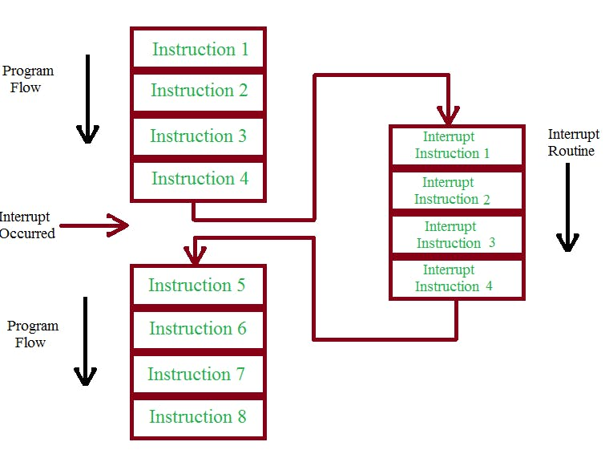
Hardware

Slide 7
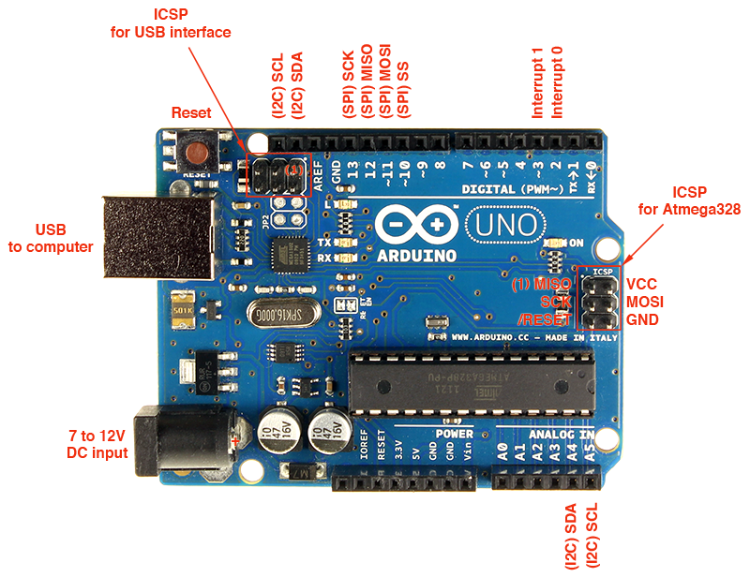
Interrupt Pins on Arduino UNO
The Uno only has two pins that can act as interrupts.
Pin2 = Interrupt 0
Pin3 = Interrupt 1
The Arduino MEGA has 6 interrupts

Slide 8
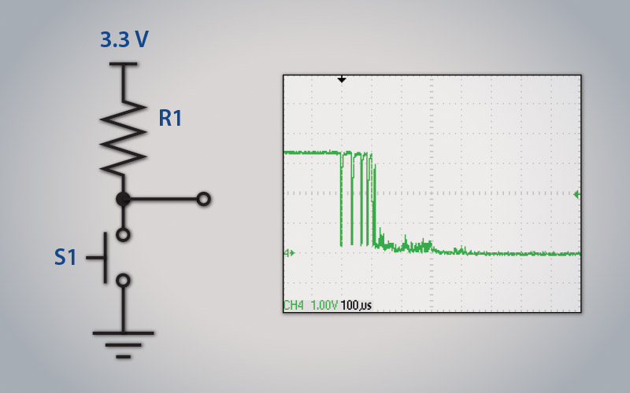
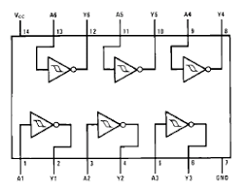
Debounce
Buttons and switches are not perfect.
When Pressed, they “Bounce” the voltage before setting on their pressed voltage.
We will use the 74HC14 Hex Inverting Schmitt trigger IC to ensure the button works correctly.
This is the hardware version of a debounced button.

Slide 9
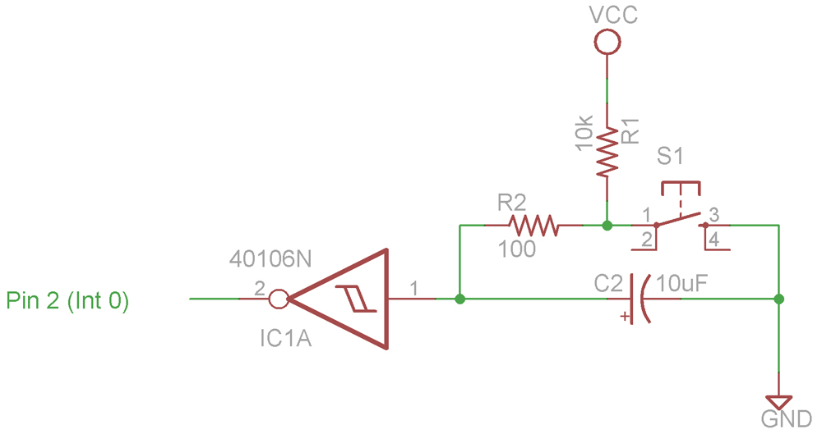
Button Debounce Schematic
Input of inverter is tied to VCC. When button is pressed, the capacitor discharges slowly through resistor.
When pin 1 is at a critical voltage the inverter output will go high.
Button release is opposite.

Slide 10
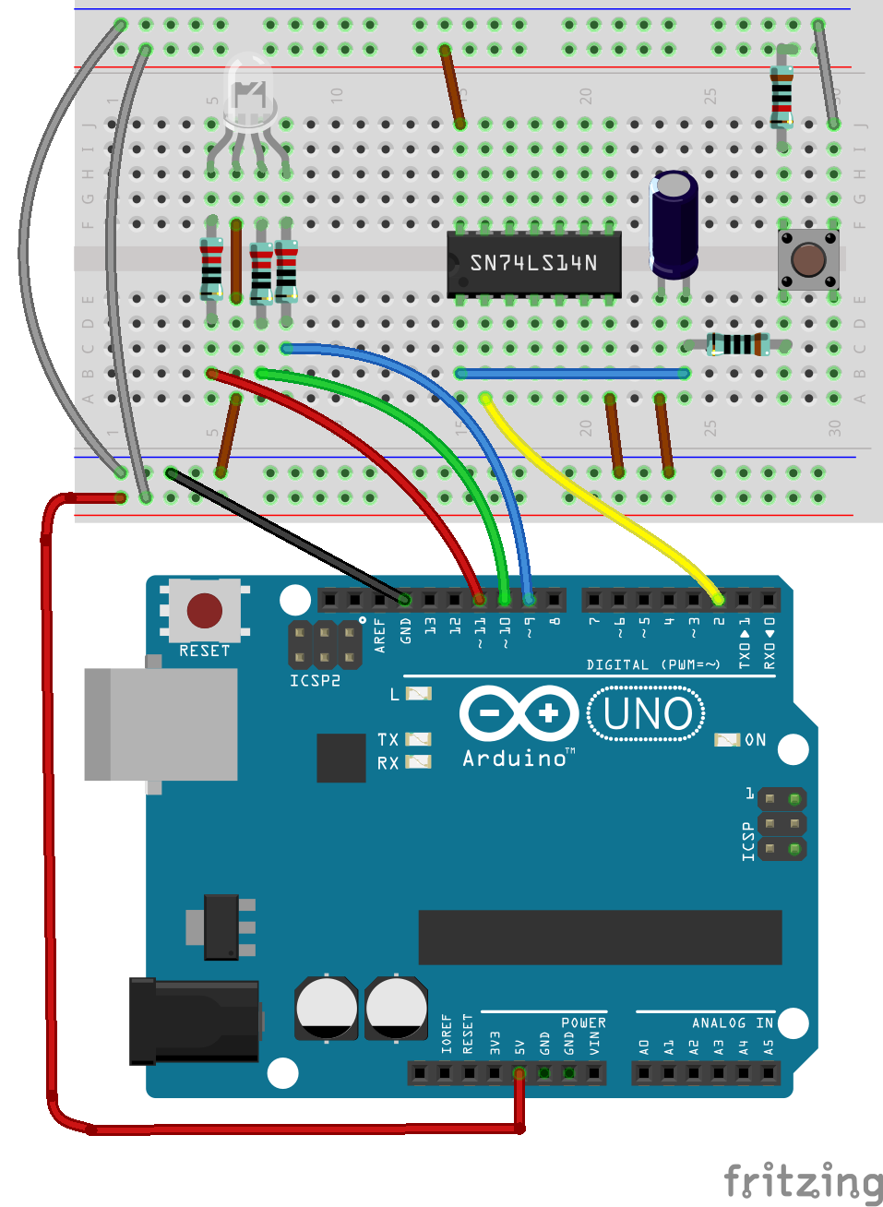
The Circuit
10k Ω
Cathode
220 Ω
10uF
1k Ω

Slide 11
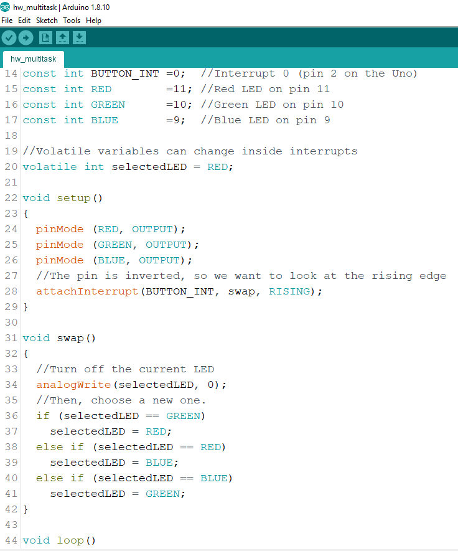
The Code
Upload hw_multitask.ino
const int BUTTON_INT sets the interrupt to interrupt 0 (Pin 2 of the Arduino Uno)
Notice the selectedLED variable is a volatile interger. This means we can change it in functions and interrupts.
attachInterrupt takes 3 parameters
BUTTON_INT – Which interrupt to use.
Swap – The name of the function we want it to run.
RISING – triggered on the rising edge of the interrupt.

Slide 12
Timer Interrupts
The Crystal Oscillator (XOSC) on the Arduino runs at 16MHz.
Timer1 is a 16 bit timer, meaning that it can count up to 2¹⁶-1, or 65,535.
Once Timer1 reaches 65,535 it resets to 0 and starts all over again.

Slide 13
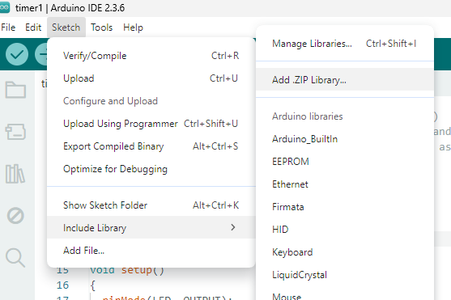
The Code
Sketch-> Include Library -> Add ZIP Library. Then find the TimerOne-master.zip file and press select.
Upload the Timer1.ino file to the Arduino Uno
Let’s look at the code next.

Slide 14
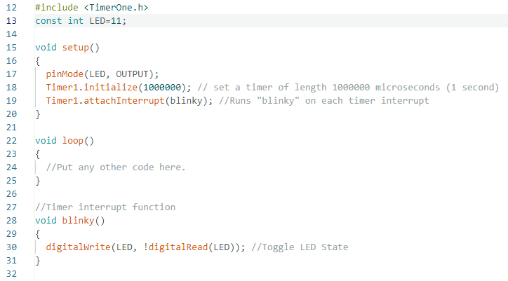
The Code
Notice we have the #include <TimerOne.h> from the library we just installed.
On line 18, we initialize the timer to 1,000,000 micro seconds ( 1 second )
On line 19, we attach the interrupt to the function blinky. This will run the function automatically every 1 second.

Slide 15
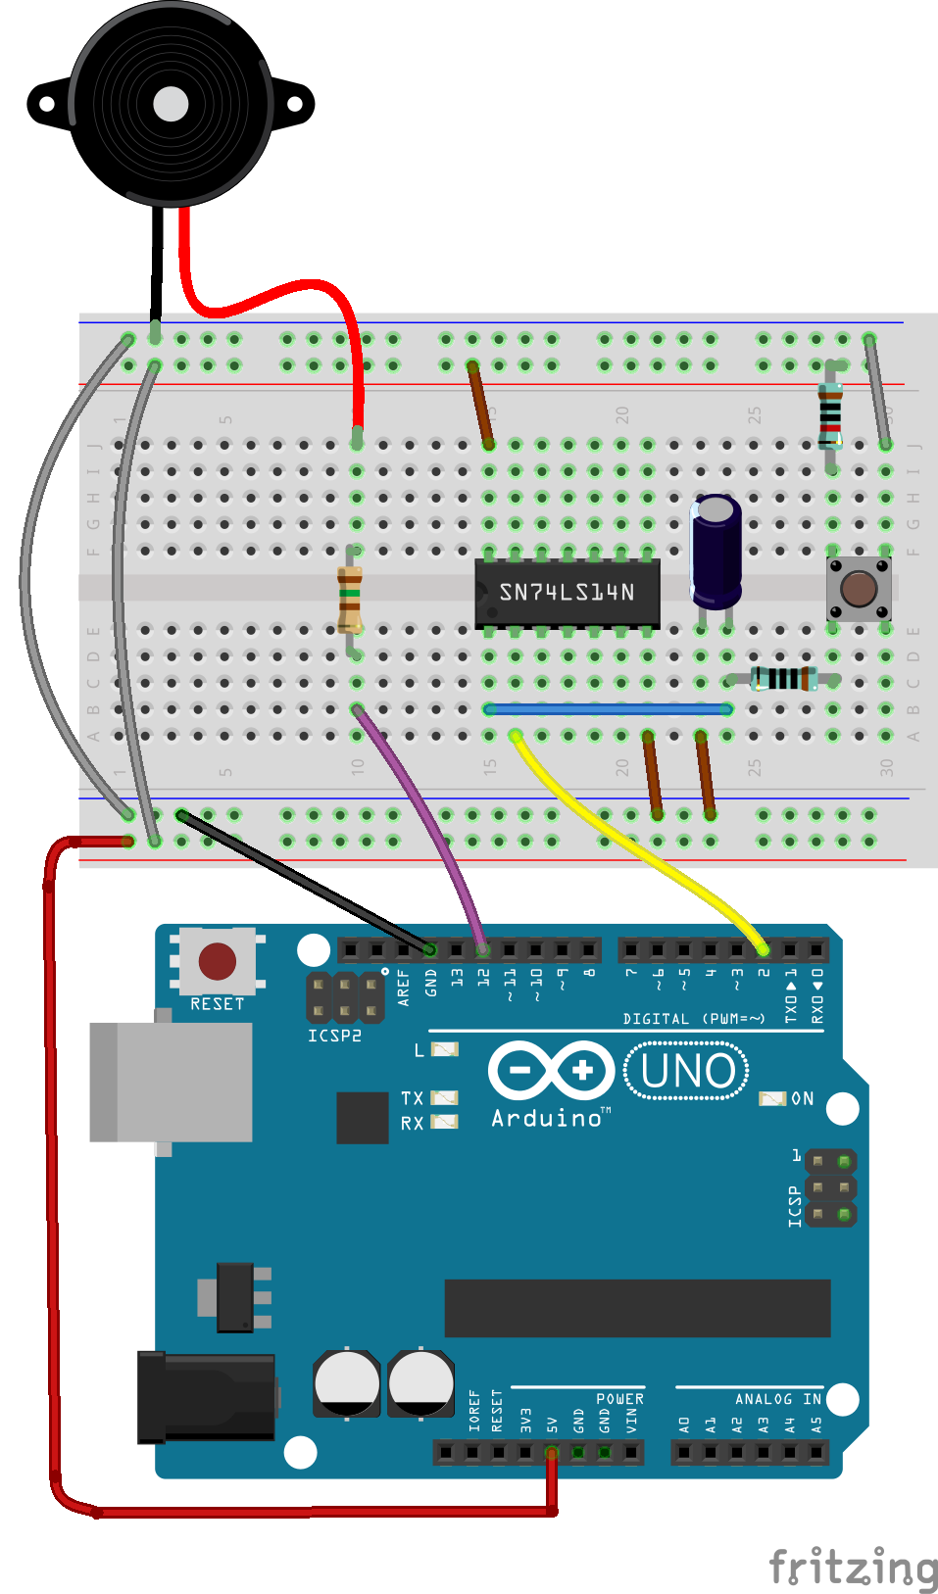
Sound Machine
Remove the RGB LED and resistors.
Remove the M-M jumpers from pins 9-11
Place a M-M jumper from pin 12 to 10B.
Place a 150Ω resistor from 10D to 10F.
Insert a speaker to the top ground rail and to 10j.
150Ω

Slide 16
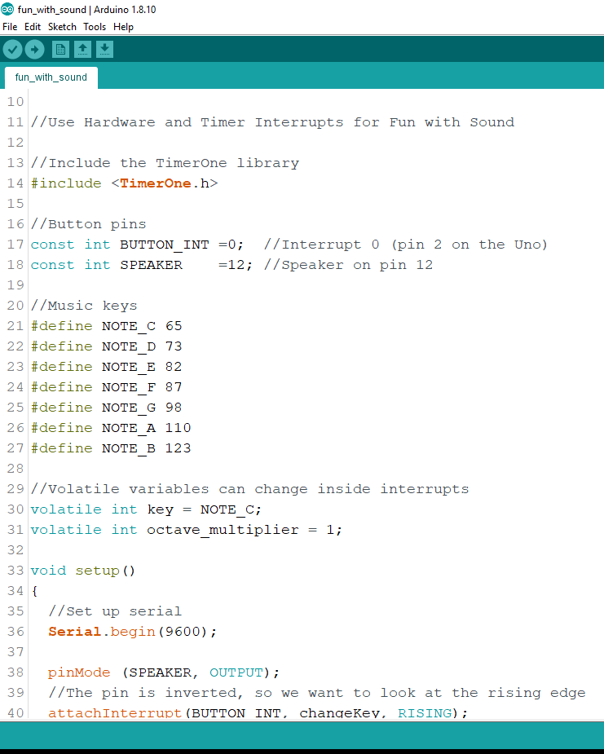
The Code
Upload “fun_with_sound.ino”
Press the button to change the Key.
Two volatile integers
Key - variable used in the changeKey function that is attached to the button interrupt.
Octave Multiplier – variable used in changePitch that is attached to the timer interrupt.

Slide 17
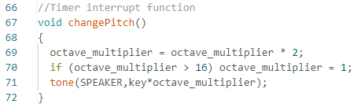
The Code
Program starts with Note C which is defined as 65Hz.
Every .5 seconds the changePitch function is called.
Octive_multiplier is set to 1. When changePitch is called it is multiplied by 2. As long as octave_multiplier is less than 16 tone will send out the key times the octave multiplier.
So, 2,4,8 will have three octaves. Then the if statement will turn octave multiplier to 1 and you’ll here the base tone. This produces 4 octaves with .5 second intervals.

Slide 18
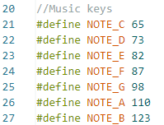
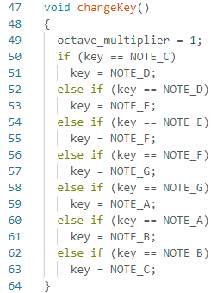
The Code
Program starts with Note C which is defined as 65Hz.
Every time you press the button, Interrupt 0 calls the changeKey function and cycles the base note from C to D to E all the way to B. The next button press turns the key back to C.

Slide 19
Clean up
Disassemble the breadboard and place all the parts back into the correct bags.
Small parts in the small bag.
Small bag and large parts into the large bag.
Turn the kit back into the lab manager.

Slide 20
Stay tuned
Arduino 11 we will build a Room Entry Logger and read and write to SD cards!

